Slide 1
Introduction to
Programming with Python
Regular Expressions

Slide 2
regular expressions
Notes:
Google Forms

Slide 3
regexes
Notes:
validate{0,1,2,3}.py

Slide 4
re

Slide 5
docs.python.org/3/library/re.html

Slide 6
re.search(pattern, string, flags=0)
Notes:
validate4.py

Slide 7
. | any character except a newline
* | 0 or more repetitions
+ | 1 or more repetitions
? | 0 or 1 repetition
{m} | m repetitions
{m,n} | m–n repetitions
Notes:
validate5.py

Slide 8
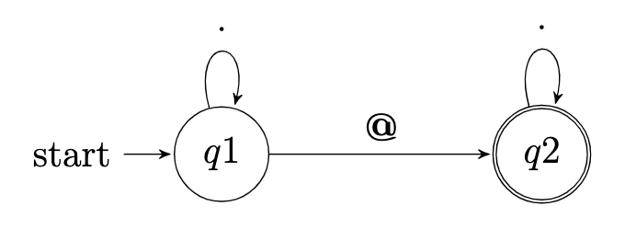
Finite State Machine or nondeterministic finite automaton
double circle is accept state
Notes:
\begin{tikzpicture}[->,>=stealth',shorten >=1pt,auto,node distance=3.5cm,
scale = 1,transform shape]
\node[state,initial] (q1) {$q1$};
\node[state,accepting] (q2) [right of=q1] {$q2$};
\path (q1) edge[loop above] node {·} (q1)
(q1) edge node {\textbf{@}} (q2)
(q2) edge[loop above] node {·} (q2);
\end{tikzpicture}

Slide 9
. | any character except a newline
* | 0 or more repetitions
+ | 1 or more repetitions
? | 0 or 1 repetition
{m} | m repetitions
{m,n} | m–n repetitions
Notes:
validate{6,7}.py

Slide 10
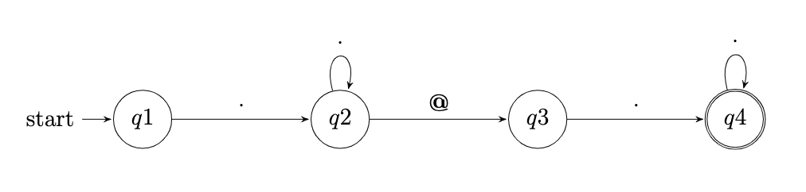
Notes:
\begin{tikzpicture}[->,>=stealth',shorten >=1pt,auto,node distance=3.5cm,
scale = 1,transform shape]
\node[state,initial] (q1) {$q1$};
\node[state] (q2) [right of=q1] {$q2$};
\node[state] (q3) [right of=q2] {$q3$};
\node[state,accepting] (q4) [right of=q3] {$q4$};
\path (q1) edge node {·} (q2)
(q2) edge[loop above] node {·} (q2)
(q2) edge node {\textbf{@}} (q3)
(q3) edge node {·} (q4)
(q4) edge[loop above] node {·} (q4);
\end{tikzpicture}

Slide 11
^ | matches the start of the string
$ | matches the end of the string or just before the newline at the end of the string
Notes:
validate8.py

Slide 12
[] | set of characters
[^] | complementing the set
Notes:
validate9.py

Slide 13
\d | decimal digit
\D | not a decimal digit
\s | whitespace characters
\S | not a whitespace character
\w | word character … as well as numbers and the underscore
\W | not a word character
Notes:
validate10.py

Slide 14
re.IGNORECASE
re.MULTILINE
re.DOTALL
Notes:
validate{11,12}.py

Slide 15
^[a-zA-Z0-9.!#$%&'*+\/=?^_`{|}~-]+@[a-zA-Z0-9](?:[a-zA-Z0-9-]{0,61}[a-zA-Z0-9])?(?:\.[a-zA-Z0-9](?:[a-zA-Z0-9-]{0,61}[a-zA-Z0-9])?)*$
Notes:
https://html.spec.whatwg.org/multipage/input.html#valid-e-mail-address

Slide 16
re.match(pattern, string, flags=0)

Slide 17
re.fullmatch(pattern, string, flags=0)

Slide 18
A|B | either A or B
(...) | a group
(?:...) | non-capturing version
https://www.geeksforgeeks.org/conditional-or-ternary-operator-in-c/
Notes:
format{0,1}.py

Slide 19
:=
Notes:
[python 3.8]
format2.py

Slide 20
re.sub(pattern, repl, string, count=0, flags=0)
Notes:
twitter{0,1,2,3,4,5}.py

Slide 21
re.split(pattern, string, maxsplit=0, flags=0)

Slide 22
re.findall(pattern, string, flags=0)

Slide 23
Introduction to
Programming with Python
Regular Expressions

